Slide 1
STUDENTS PERFORMANCE IN EXAMS ANALYSIS
CAPSTONE PROJECT
Presented By:
LOGESH.K
2021309023
COLLEGE NAME: ALGAPPA COLLEGE OF TECHNOLOGY , ANNA UNIVERSITY
DEPARTMENT: B.TECH TEXTILE TECHNOLOGY

Slide 2
OUTLINE
Problem Statement
Proposed System/Solution
System Development Approach
Algorithm & Deployment
Result
Conclusion
Future Scope
References

Slide 3
Problem Statement
This project aims to understand how student performance (test scores) is influenced by various factors, including Gender,Parental Level of Education, Lunch.

Slide 4
Proposed Solution
Utilizing advanced machine learning algorithms, our solution will analyze extensive students performance in exams to establish patterns and correlations.
Solution could be to conduct a comprehensive statistical analysis using techniques such as regression analysis or machine learning algorithms.
This would involve examining the correlation between student performance and each of the mentioned factors (gender, race, parental level of education, lunch, test preparation course) while controlling for other variables.
Additionally, visualizations like matplotblob, seaborn can help to illustrate patterns and relationships in the data.

Slide 5
System Approach
Building the proposed solution would involve a combination of data processing, feature engineering, and machine learning. Here are the key system and library requirements:
System Requirements:
Hardware:- A computer with sufficient processing power, preferably with multiple cores or a GPU for faster training of machine learning models.- Adequate RAM to handle the size of the dataset and computational requirements.
Software: An operating system compatible with the required machine learning libraries (e.g., Windows, Linux, macOS).

Slide 6
System Approach
Library Requirements:
Data Processing and Analysis:-
Pandas: For data manipulation and analysis.-
NumPy: For numerical operations on data.
Data Visualization:-
Matplotlib and Seaborn : For creating visualizations to understand data patterns.

Slide 7
Algorithm & Deployment
Designing an algorithm for analyzing student performance typically involves several steps:
1. *Data Collection*: Gather data on students' performance in exams, including scores, demographic information (gender, ethnicity), parental level of education, lunch status, and whether they took a test preparation course.
2. *Data Cleaning and Preprocessing*: Clean the data by removing any errors or inconsistencies, and preprocess it by handling missing values and encoding categorical variables.
3. *Feature Engineering*: Create new features or transform existing ones to better represent the relationships between the variables. For example, you might create a feature indicating whether a student received free lunch or not based on their lunch status.

Slide 8
Algorithm & Deployment
4. *Model Selection*: Choose appropriate machine learning models for predicting student performance based on the features available. This could include regression models, classification models, or more complex models like random forests or neural networks.
5. *Model Training*: Train the chosen model on a portion of the data, using techniques like cross-validation to ensure generalization to unseen data.
6. *Model Evaluation*: Evaluate the performance of the trained model using appropriate metrics, such as accuracy, precision, recall, or mean squared error, depending on the nature of the problem (classification or regression).

Slide 9
Algorithm & Deployment
7. *Deployment*: Deploy the trained model in a suitable environment, such as a web application or API, where it can be used to make predictions on new data.
When deploying the model, it's important to consider factors like scalability, latency, and security. Additionally, regular monitoring and updates may be necessary to ensure the model continues to perform well as new data becomes available or as the underlying factors influencing student performance change over time.

Slide 10
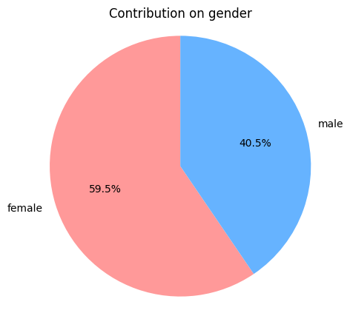
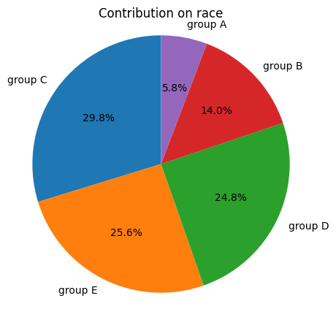
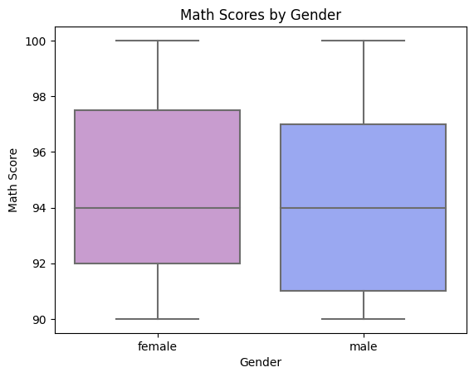
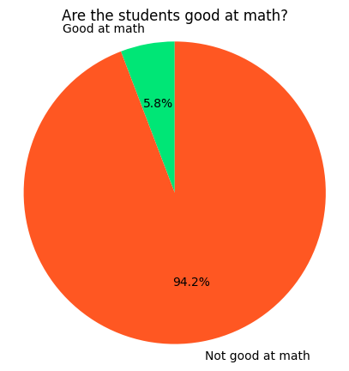
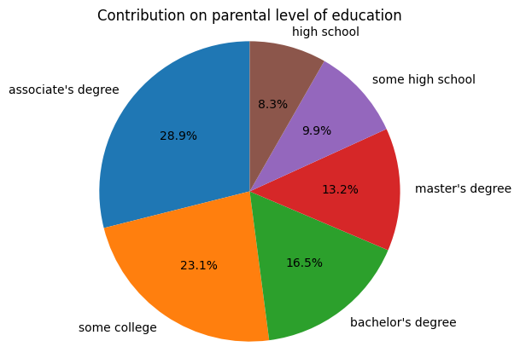
RESULT

Slide 11
Conclusion
In Conclusion,After analyzing the data on student performance in exams, it is evident that various factors play significant roles in influencing academic outcomes. Gender, ethnicity, parental level of education, access to lunch, and participation in test preparation courses all contribute to variations in student performance. Specifically, any disparity students from a lower Socioeconomic status have a lower avg in all course subjects and Students who get Standard Lunch tend to perform better than students who got free/reduced lunch observed among different groupsand maths grades differs largely between genders]. These findings underscore the importance of addressing equity in education and implementing targeted interventions to support students from diverse backgrounds in achieving academic success.

Slide 12
Future scope
By leveraging historical data and machine learning algorithms, educational institutions can develop models to predict the likelihood of academic success for individual students based on their demographic and socioeconomic characteristics.
This proactive approach can help identify at-risk students early on and implement targeted interventions to improve their academic performance and overall educational experience.
Additionally, further research could explore the intersectionality of these factors to gain a deeper understanding of how multiple variables interact to influence student outcomes.

Slide 13
References
https://www.kaggle.com/datasets
https://pandas.pvdata.org/pandas-docs/stable/user guide/index.html
https://seaborn.pydata.org/
https://matplotlib.org/stable/contents.html

Slide 14
THANK YOU

